Slide 1


WGCEPH 2020
Estimating abundance of Loligo Vulgaris in the Bay of Biscaywith SPiCT model
Ane Iriondo, Leire Ibaibarriaga, Marina Santurtun

Slide 2
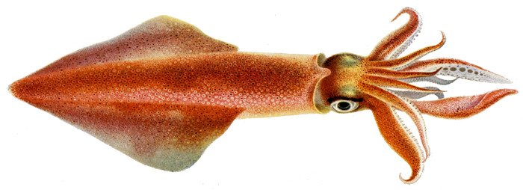
Introduction: Squid in the Bay of Biscay
Available data: abundance index from EVHOE survey and total landings
Schaeffer production method
SPiCT production model parametrization
Conclusions
.

Slide 3
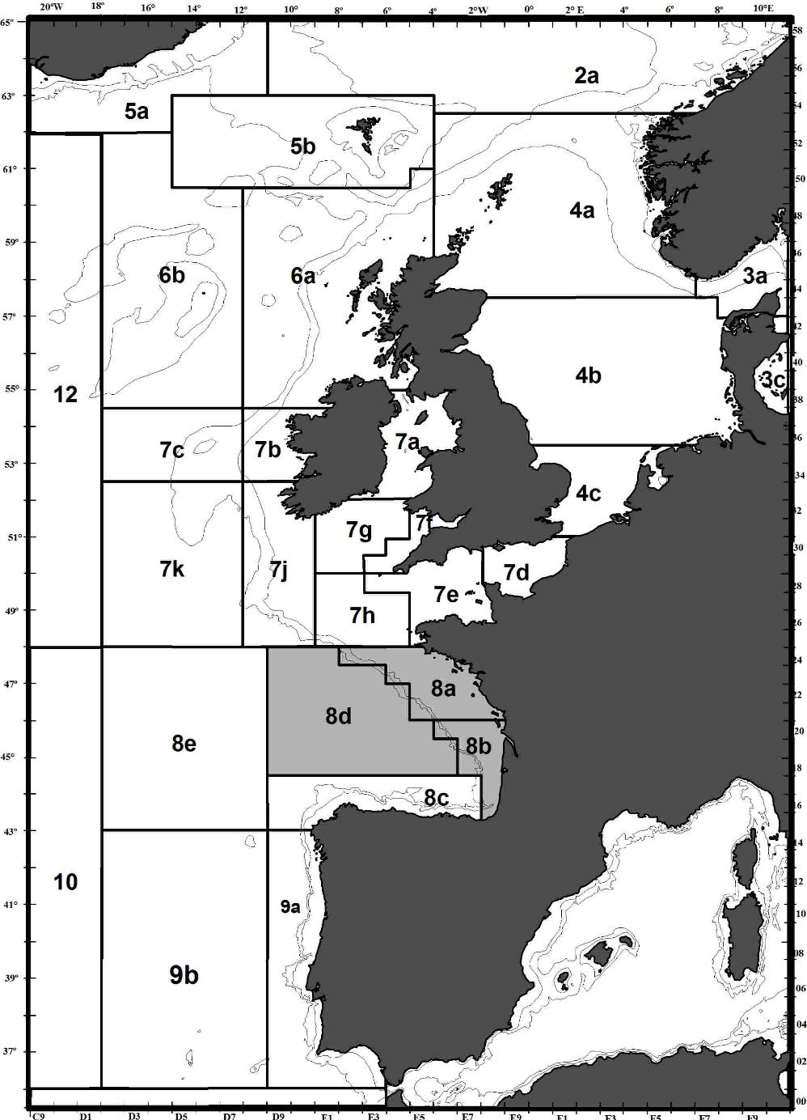
SQUID IN THE BAY OF BISCAY
Short-lived species.
High natural mortality.
Large interannual fluctuations.
Very-dependent on environment.
Distributed from ICES Subarea 3 to Division 9a, Mediterranean waters and North African coast.
ICES considers all the information in 8abd as a unit.
.

Slide 4
ABUNDANCE INDEX
Fishery-independent abundance index from EVHOE for all Loligo spp.
Disaggregated by species according to the percentage of the survey catches corresponding to each species.
.

Slide 5
LANDINGS
Exploited in a multi-specific and mix-fisheries trawlers.
Information on landings by country and ICES area.
When there is no disaggregation by species, we assumed the same % as in the EVHOE survey.
.

Slide 6
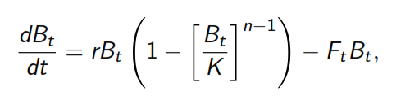
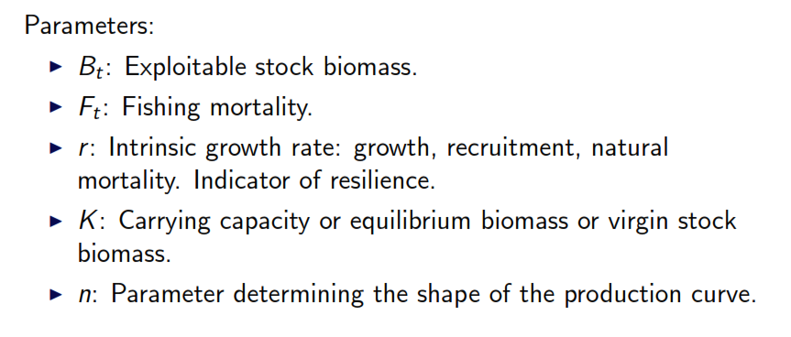
Surplus production model
Pella & Tomlinson (1969):
.

Slide 7
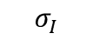
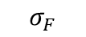
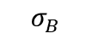
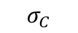
SPICT (Stochastic surplus production model in continuous time)
BIOMASS
PROCESS
$$σ_{B}$$
PROCESS ERROR
FISHING
PROCESS
$$σ_{F}$$
PROCESS ERROR
$$σ_{I}$$
OBSERVATIONS
OBSERVATION ERRORS
$$σ_{C}$$

Slide 8
SPiCT Model advantages:
Separation of process and observation noise.
Explicit modelling of Ft process allowing for prediction and missing values.
Observation error on both index and catch.
Irregular sampling intervals allowed.
Seasonal dynamics can be accommodated.
Improved precision if sub-annual observations are available.

Slide 9
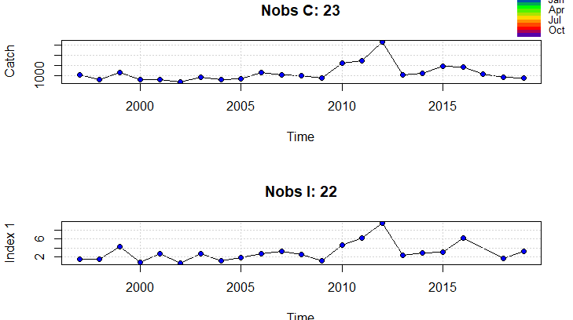
Input data

Slide 10
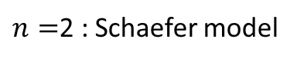
SPiCT parameters:
Often there is not enough information to estimate all model parameters, it is therefore important to quantify parameter uncertainty.
Data contained too little information to allow unconstrained estimation of parameters α, β and n.
Therefore several parameters fixing simulation were done to analyse the different convergence of the model.
$α=\frac{σ_{I}}{σ_{B}}$: ratio between observation and process error
$β=\frac{σ_{C}}{σ_{F}}:$ ratio between observation and process error
$n=$2 : Schaefer model

Slide 11
SPiCT runs: 12 cases were conducted.
SPICT | n=estimated | n=2 | n=estimated | n=2
Convergence |  |  | Prior r | Prior r
α estimated | Case 1a=NO | Case 4a=NO | Case 1b | Case 4b=NO
β estimated
α=1 | Case 2a | Case 5a | Case 2b | Case 5b
β=1
α=4 | Case 3a | Case 6a | Case 3b | Case 6b
β=1
Notes:
El parámetro n nos da la forma de la curva de producción. Cuando n=2 se corresponde con el modelo de Schaeffer y la curva es simétrica. Biológicamente es discutible si la curva es simétrica o no, pero si no se puede estimar bien ese parámetro es una asunción bastante común. En el artículo de Pedersen and Berg (2016) en el ejercicio de simulación, ellos ponen algo así:
We assessed to which extent models of different complexity were identifiable given the data by first estimating a baseline model with a spline-based
seasonal representation while fixing a = 1 and n = 2, which are standard assumptions (Ono et al. 2012; Thorson et al. 2013) and fixing b = 1.
Luego en la discusión también ponen que ellos estiman bien la n, pero como en este caso hay mucha incertidumbre, si vamos a fijar algo, fijar la n es como lo más fácil…

Slide 12
Model selection criteria: AIC comparison of all simulations
SPICT | n=estimated | n=2 | n=estimated | n=2
Convergence |  |  | Prior r | Prior r
α estimated | Case 1a=NO | Case 4a=NO | Case 1b= 104.6227 | Case 4b=NO
β estimated
α=1 | Case 2a= 81.02054 | Case 5a= 68.46823 | Case 2b= 83.49258 | Case 5b= 70.30613
β=1
α=4 | Case 3a= 86.70934 | Case 6a= 71.87238 | Case 3b= 89.2018 | Case 6b= 74.01433
β=1

Slide 13
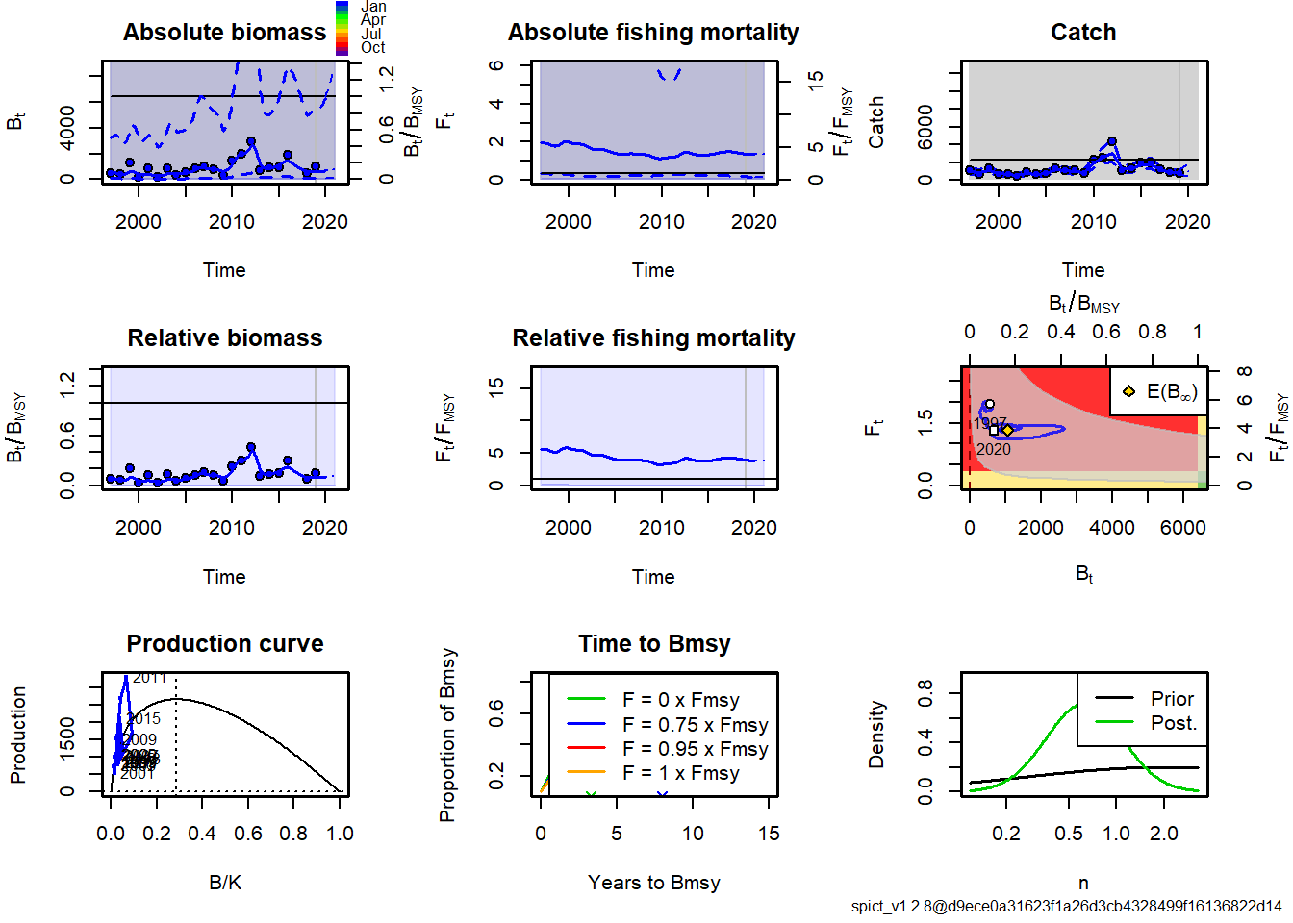
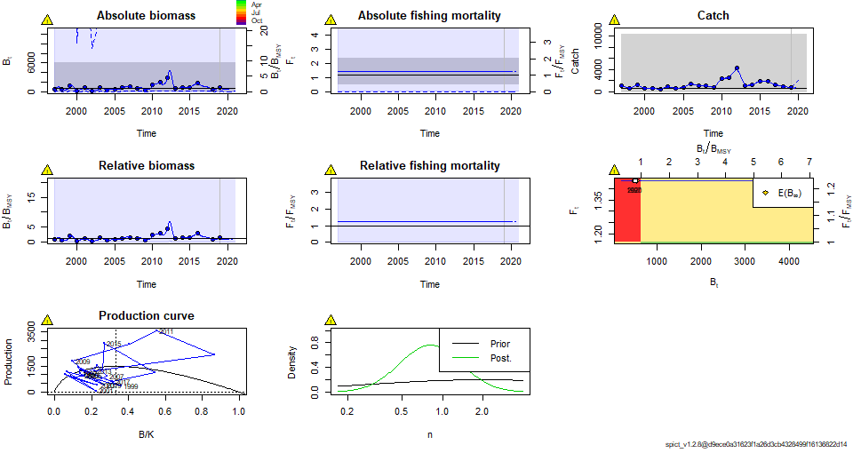
Fitting the model: Case 1a
Fitting the model: Case 2a
## Convergence: 1 MSG: false convergence (8) ## WARNING: Model did not obtain proper convergence! Estimates and uncertainties are most likely invalid and cannot be trusted.
Convergence: 0 MSG: relative convergence (4)

Slide 14
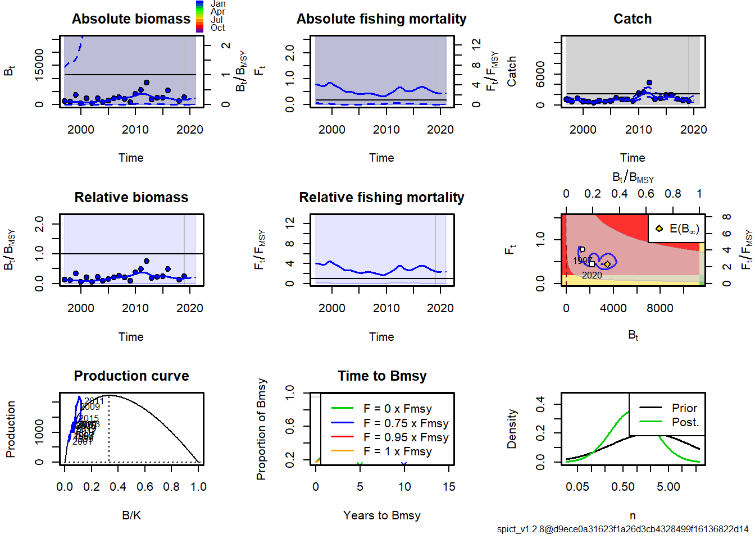
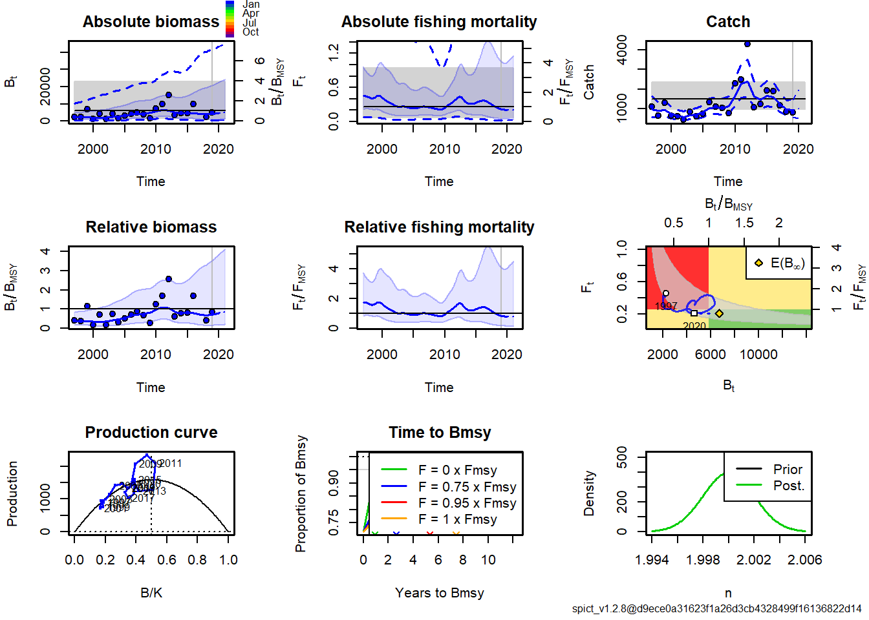
Fitting the model: Case 6a
Fitting the model: Case 3a

Slide 15
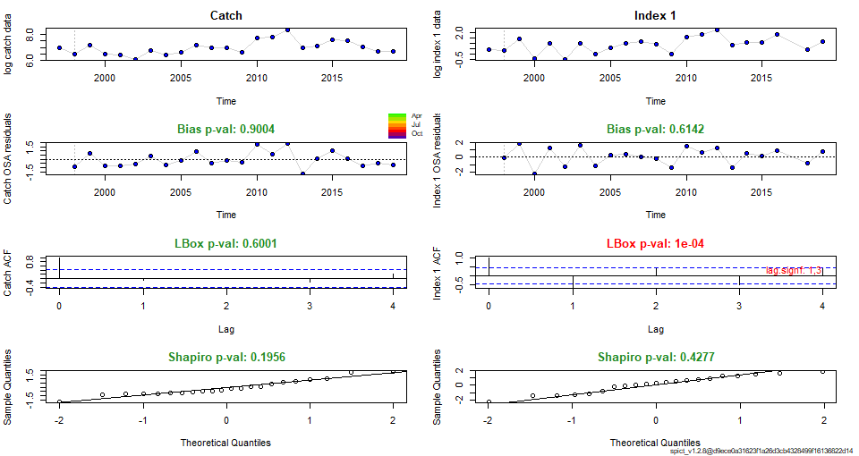
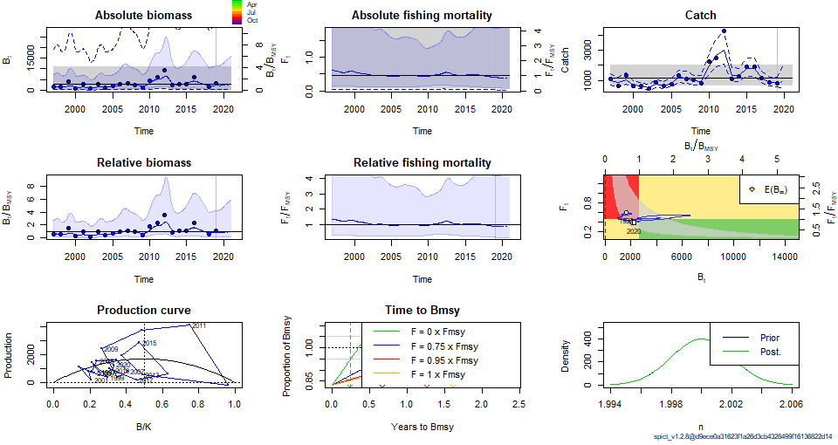
FINAL MODEL: Case 5a: alpha=beta=1 and n=2 (Schaefer model)
Residual diagnostics
Assessment results

Slide 16
FINAL MODEL: Case 5a: alpha=beta=1 and n=2 (Schaefer model)
REFERENCE POINTS
MODEL PARAMETERS and 95% CI
Convergence: 0 MSG: relative convergence (4)
Objective function at optimum: 26.2341151
Euler time step (years): 1/16 or 0.0625
Nobs C: 23, Nobs I1: 22
Priors
logn ~ dnorm[log(2), 0.001^2] (fixed)
logalpha ~ dnorm[log(1), 0.001^2] (fixed)
logbeta ~ dnorm[log(1), 0.001^2] (fixed)
Model parameter estimates w 95% CI
estimate cilow ciupp log.est
alpha 0.9999987 0.9980406 1.001961e+00 -0.0000013
beta 1.0000020 0.9980439 1.001964e+00 0.0000020
r 1.0061880 0.2853067 3.548512e+00 0.0061689
rc 1.0061900 0.2853071 3.548521e+00 0.0061709
rold 1.0061920 0.2853067 3.548540e+00 0.0061729
m 1702.5889030 1014.1755846 2.858291e+03 7.4399053
K 6768.4640484 1514.1206205 3.025658e+04 8.8200295
q 0.0010155 0.0000961 1.073480e-02 -6.8924056
n 1.9999961 1.9960799 2.003920e+00 0.6931452
sdb 0.4886517 0.3622857 6.590946e-01 -0.7161052
sdf 0.2110432 0.1275477 3.491968e-01 -1.5556923
sdi 0.4886511 0.3622862 6.590919e-01 -0.7161065
sdc 0.2110437 0.1275482 3.491968e-01 -1.5556902
Deterministic reference points (Drp)
estimate cilow ciupp log.est
Bmsyd 3384.229461 757.0590772 15128.28970 8.1268815
Fmsyd 0.503095 0.1426536 1.77426 -0.6869763
MSYd 1702.588903 1014.1755846 2858.29103 7.4399053
Stochastic reference points (Srp)
estimate cilow ciupp log.est rel.diff.Drp
Bmsys 2667.393455 653.4100119 10889.009523 7.8888570 -0.2687403
Fmsys 0.450143 0.1052668 1.924907 -0.7981899 -0.1176337
MSYs 1162.750687 669.2667943 2020.104945 7.0585438 -0.4642768
STOCK STATUS
B_2019.00 2219.611 163.948 30050.218782 7.7050873
F_2019.00 0.402133 0.0285682 5.660516 -0.9109724
B_2019.00/Bmsy 0.8321274 0.1648653 4.200010 -0.1837697
F_2019.00/Fmsy 0.8933449 0.1914966 4.167517 -0.1127825
Biomass below Bmsy
F below Fmsy

Slide 17
Conclusions:
Despite effort is done to improve the knowledge on cephalopod biology and fisheries, there are many data issues not fully resolved yet like species identification.
Additional assumptions were needed to get model convergence. Results are still highly uncertain.
Additional information on the stock, like a recruitment index would allow considering alternative models, more suitable for short-lived stocks.
In the Parameters fixing simulation done in WGCEPH 2020 the biological significance of the fixing should be reviewed.

Slide 18




